Slide 1



























OUR SPONSORS
Speaker: Antonio Di Turi
Company: Data Reply
Energy aware CI/CD pipeline
With Kepler

Slide 2

Agenda
Why am I doing this?
TAG ENV Sustainability
WG Green Reviews
Demo Architecture
What is Kepler?
Live Demo

Slide 3


Goals:
Familiarize with Kepler
Provide a simple use case
Explain what WG Green review is doing
Invite to make experiments on a local setup
Non Goals:
Show best practice in CI/CD
Show best tooling for CI/CD
Show production like scenarios for CI/CD
Show complex code optimization

Slide 4

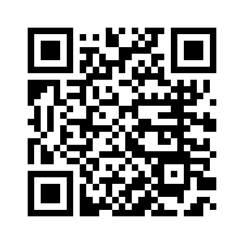
Who am I?
Senior consultant ad Data Reply DE
Cloud Native Sustainability Enthusiast
Co-chair WG green reviews in the TAG Environmental Sustainability
Get in
touch

Slide 5
The TAG Env Sus
…and its short name

Slide 6

TAG ENV Sustainability
Founded in May 2022
TAG's goals (apply for open source and cloud native space):
Advocate for, develop, support, and help evaluate environmental sustainability initiatives
Identify values and possible incentives to reduce energy and resource consumption and ecological footprint
Raise awareness of importance of environmental sustainability
Support projects contributing to the cloud native sustainability domain
All activities in the TAG are done in a transparent manner and are open for everyone to join and contribute!

Slide 7
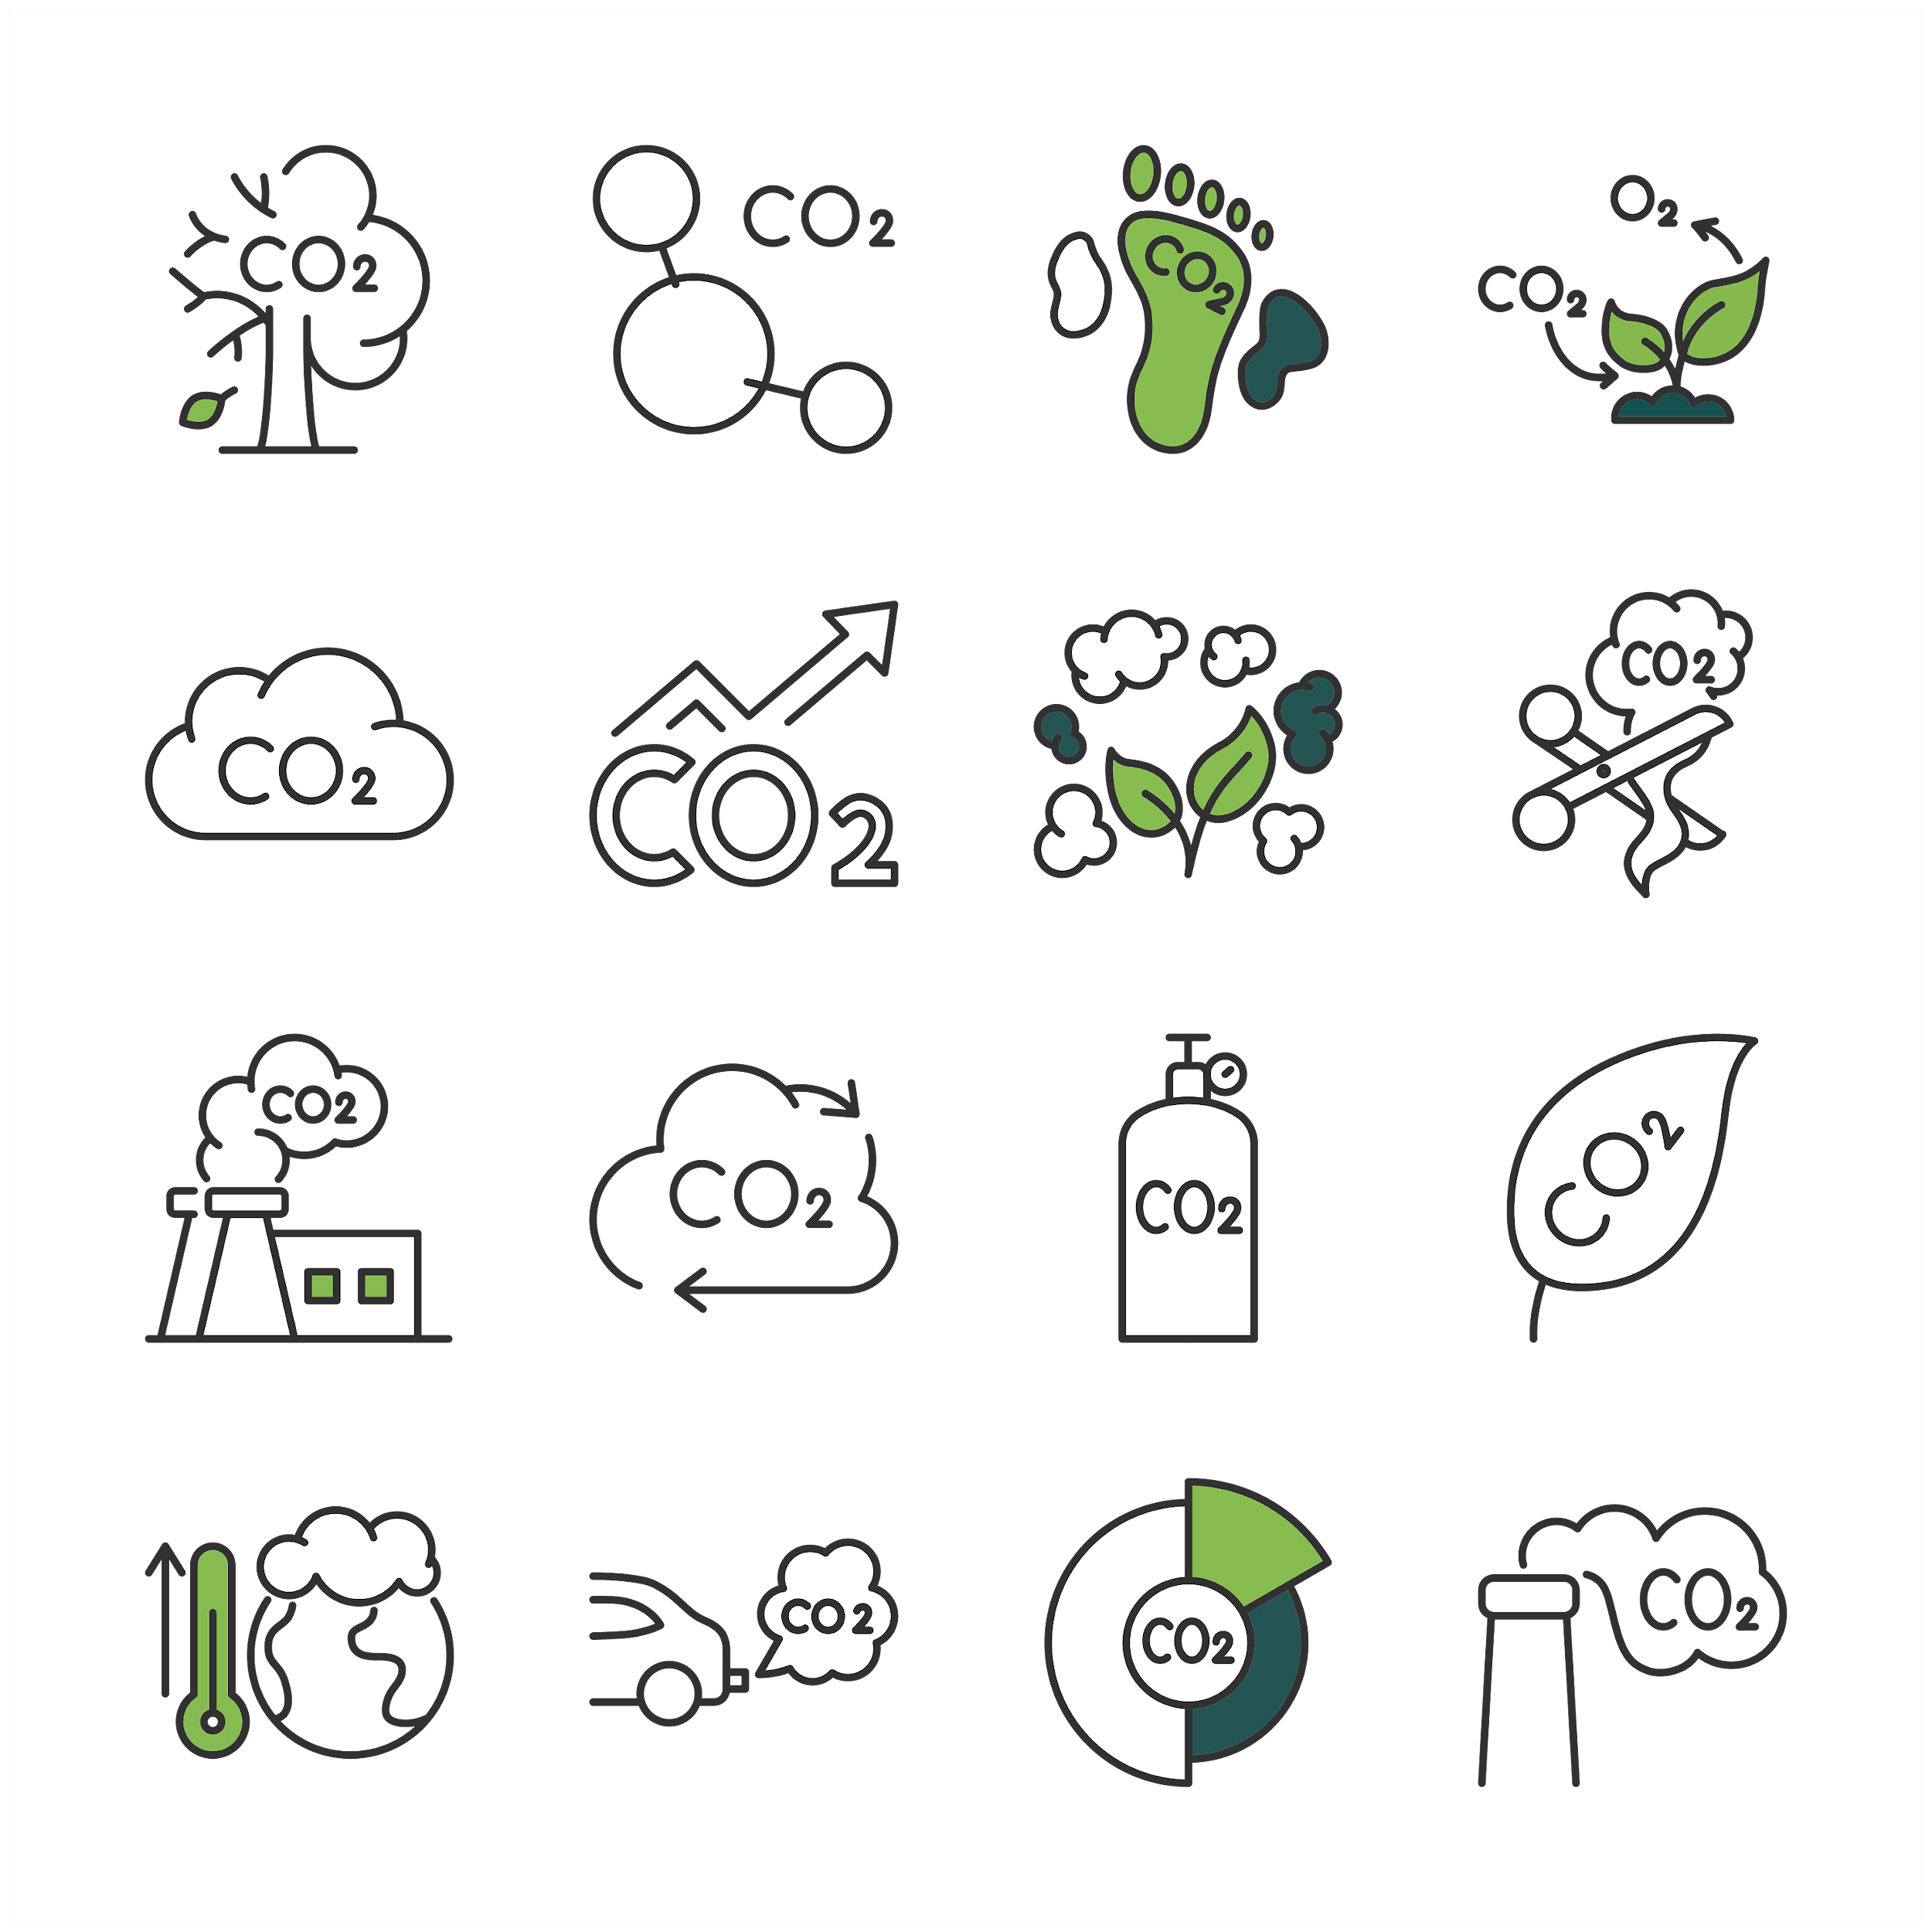
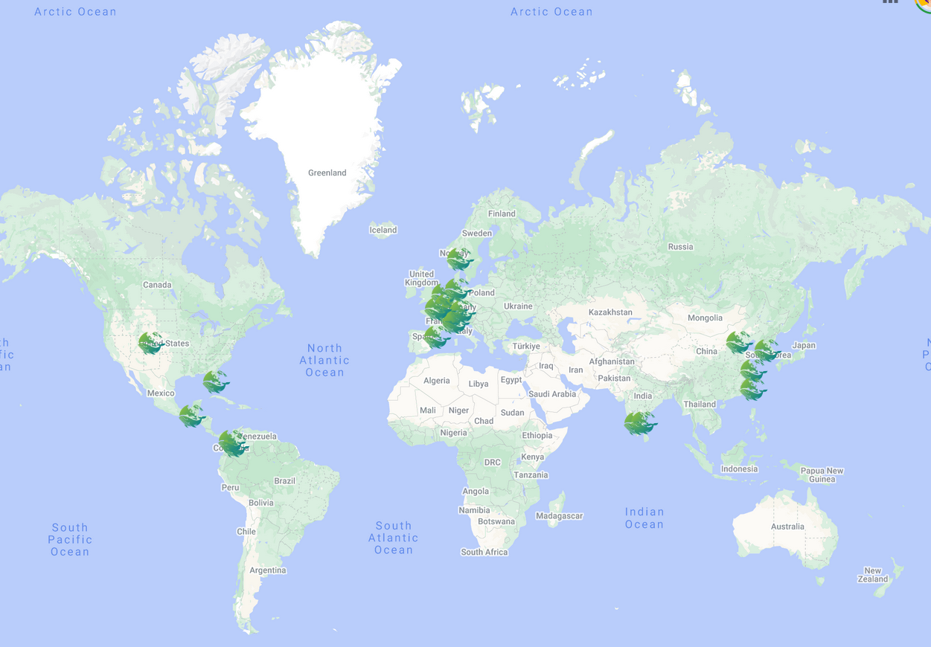
Cloud Native Sustainability Week
21 Meetups
22+ Meetups
Virtual Mini Conference
Virtual Mini Conference
Organized by CNCF && TAG ENV since 2023
Mission is to unite the community to:
Understand Current Landscape
Identify Knowledge Gaps
Foster Project Collaboration
Raise Awareness
Promote TAG ENV and CNCF
Gather Community Insights
Acknowledge Contributors
Looking for contributors for 2024 event! Can it be YOU?😃
Daily Blog Posts
Daily Livestream
Daily Blog Posts
Daily Livestream

Slide 8
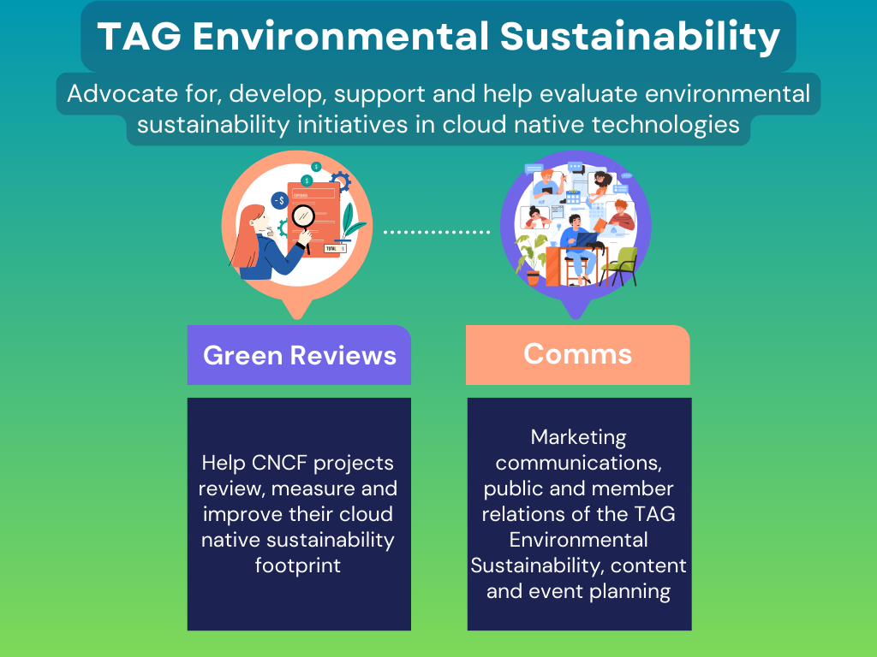

Slide 9
The WG Green Reviews
What we did

Slide 10

WG Green Reviews: Intro
Responds
the CNCF needs
Awareness of the challenges related to environmental sustainability.
Need for a systematic approach to assess projects’ sustainability footprint
Need to integrate an environmental sustainability review in release cycle.
Green Reviews WG helps CNCF projects to review sustainability footprint.
Enables stakeholders to promote long-term viability and environmental responsibility assessing and improving the sustainability footprint

Slide 11

WG Green Reviews: Scope
Acts within the CNCF Environmental Sustainability TAG Charter.
Provide metrics, guidelines, guidance, and processes for measuring and improving the sustainability footprint of CNCF projects.
Initiate a CNCF project review at the discretion of the Working Group.
Leverage existing tools, libraries, and frameworks for conducting CNCF project sustainability footprint reviews whenever possible.
Be a point of contact for project maintainers to understand the outcome of the projects’ reviews.

Slide 12
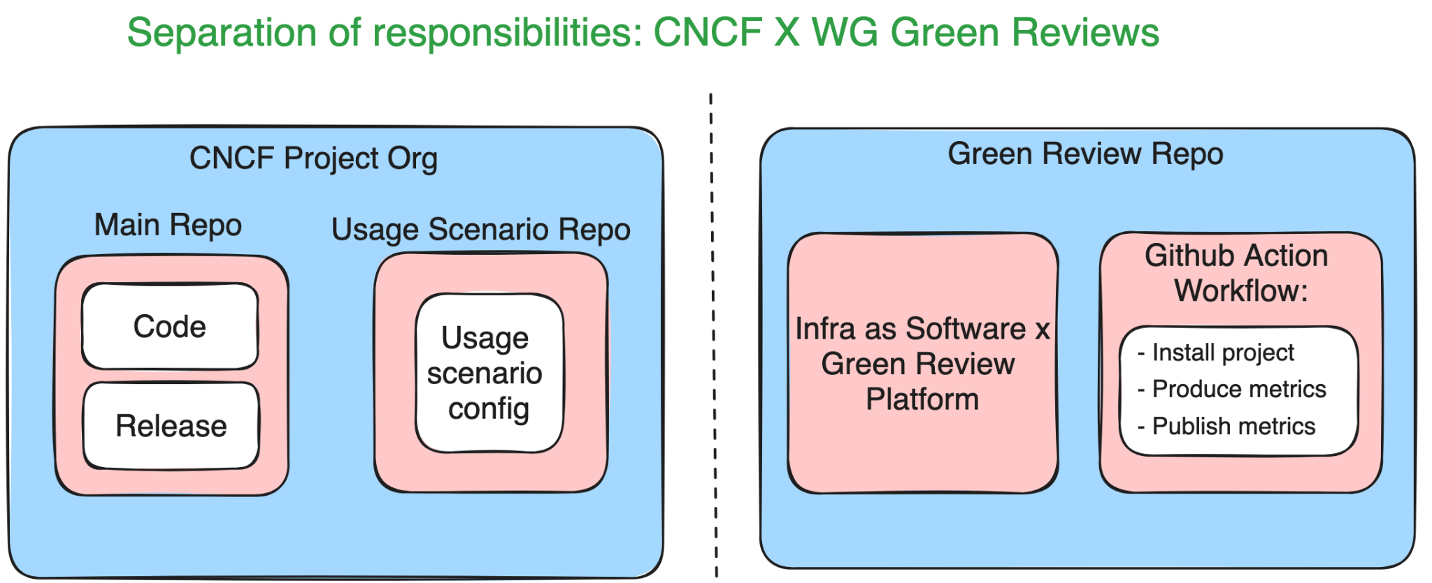

Slide 13
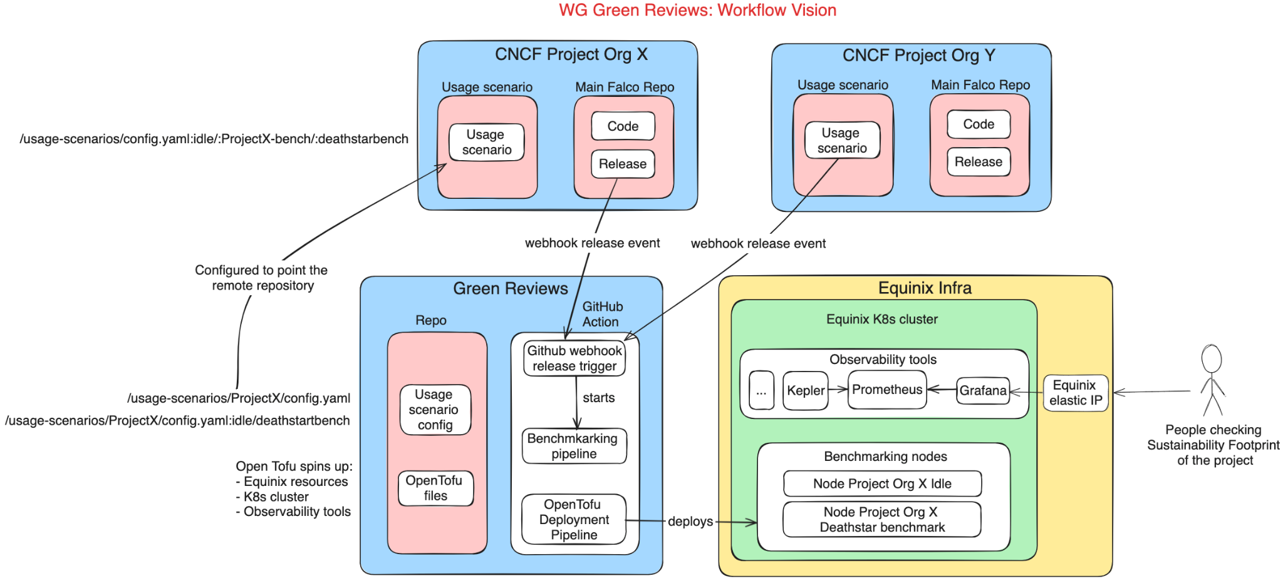
Workflow vision

Slide 14
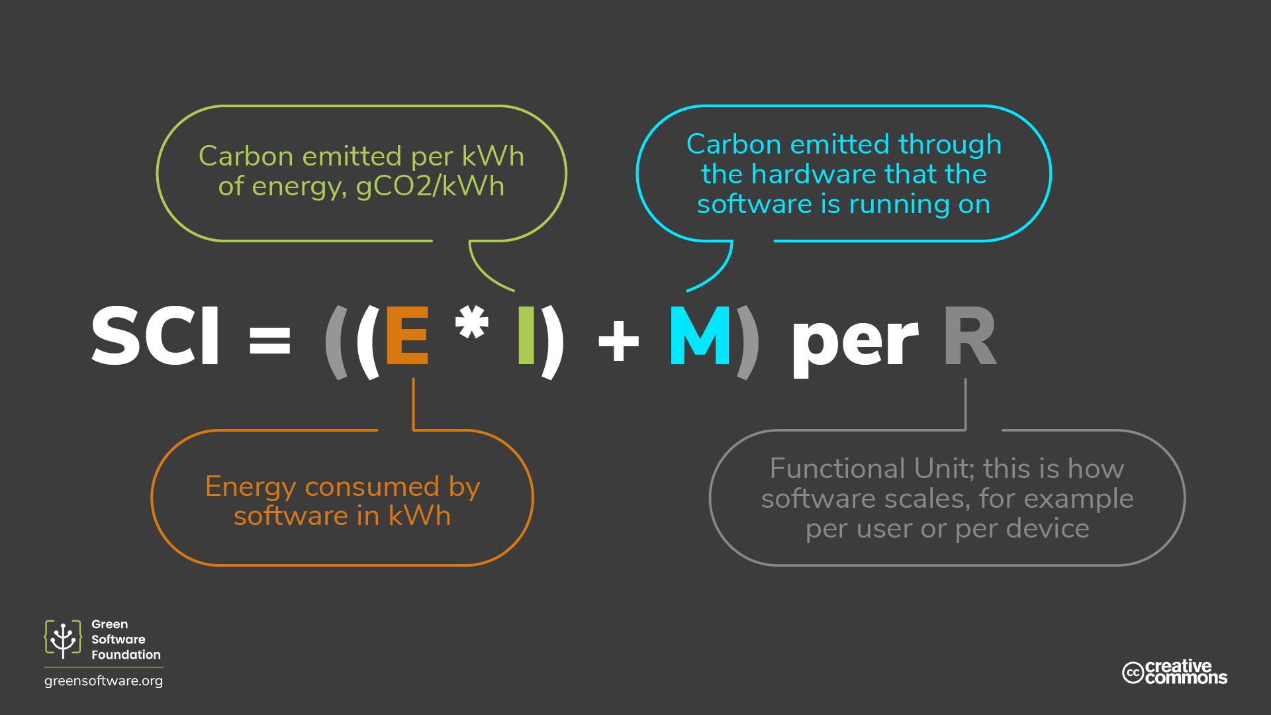

Slide 15
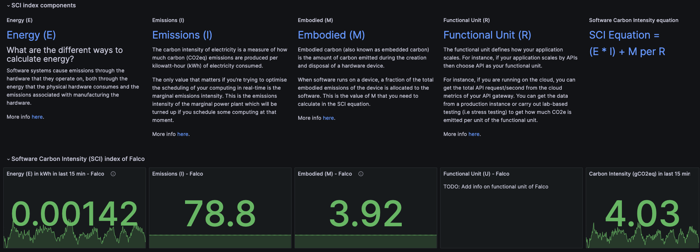
Our first metrics

Slide 16
The WG Green Reviews
What we are doing

Slide 17
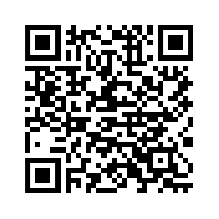
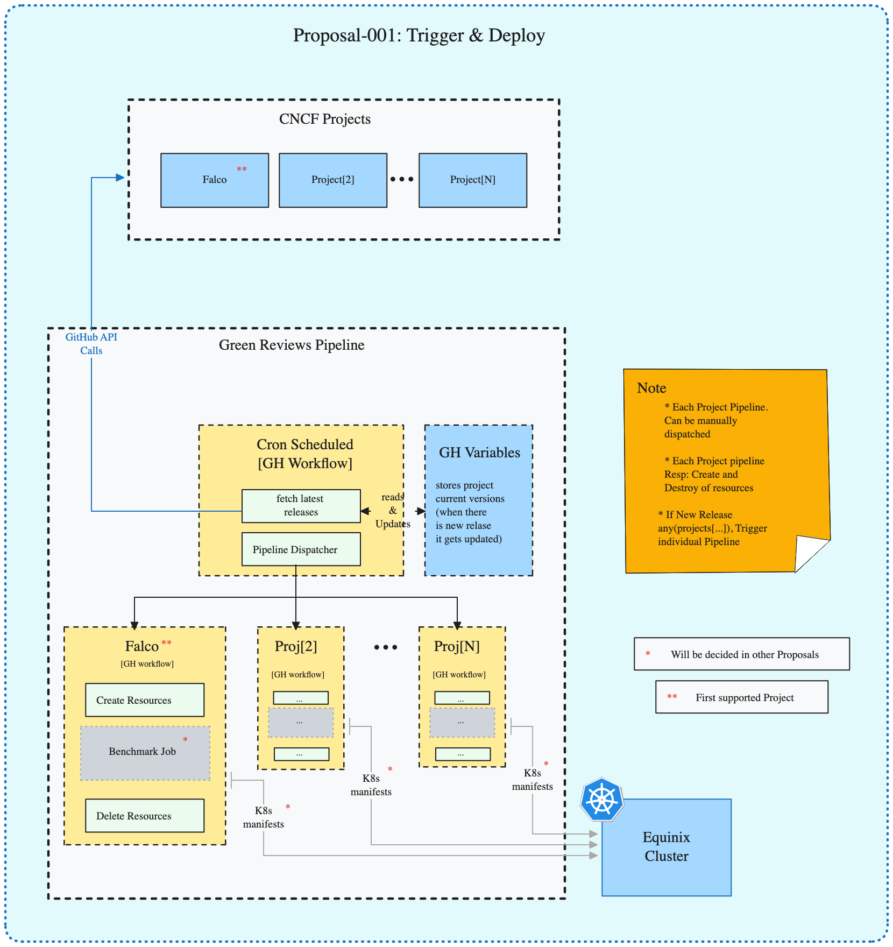
WG Agenda
Structuring a process
1. Deploy
2. Benchmark
3. Report
4. Deeper Benchmark investigation
https://github.com/cncf-tags/green-reviews-tooling/issues/83

Slide 18


Slide 19
Demo
…that even a working student could do

Slide 20

Background
You have been assigned a working student
He is new to k8s
He is new to Prometheus and Grafana
We make him a new assignment: deploy a Fibonacci pod

Slide 21


Slide 22
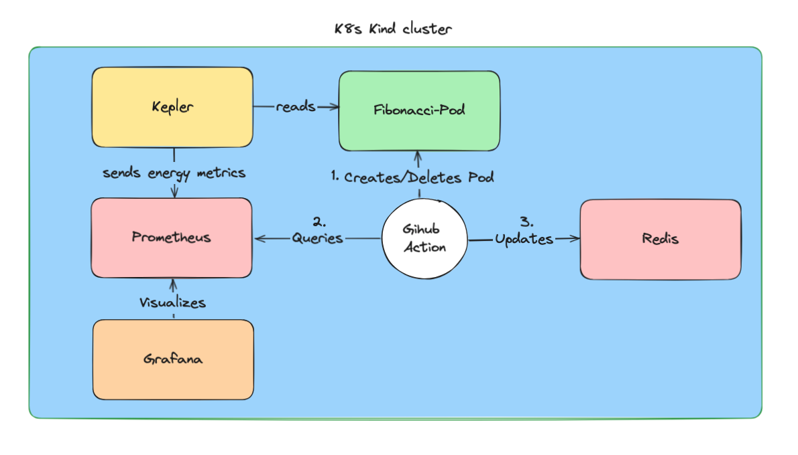

Slide 23
What is Kepler?

Slide 24
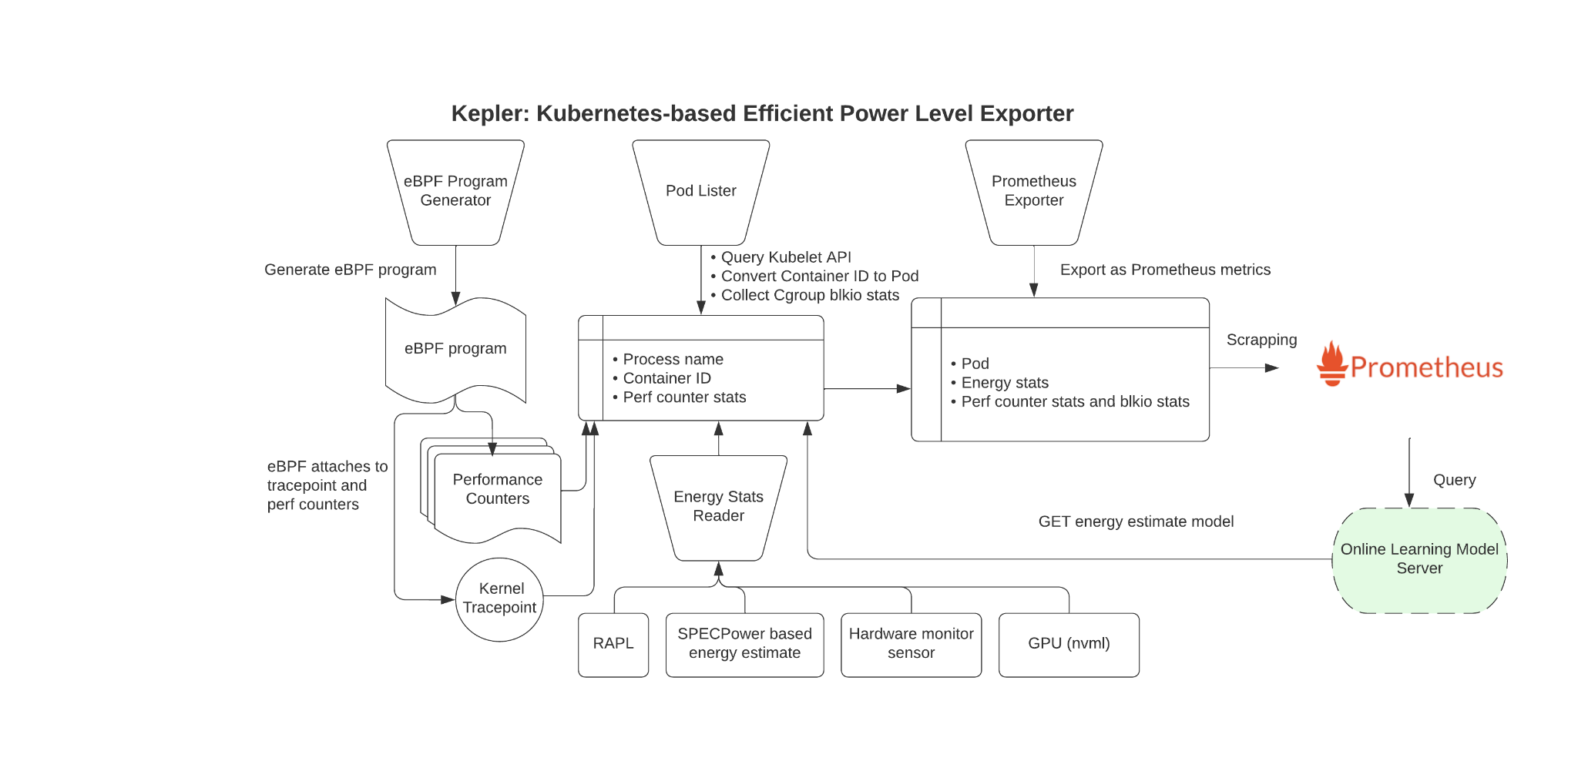

Slide 25
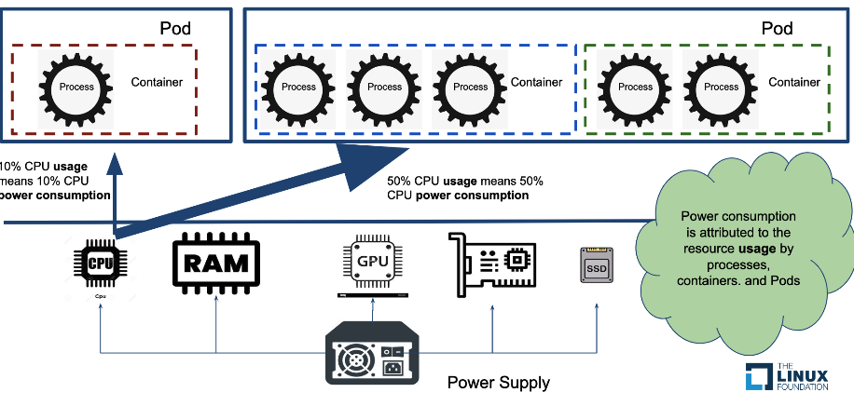

Slide 26
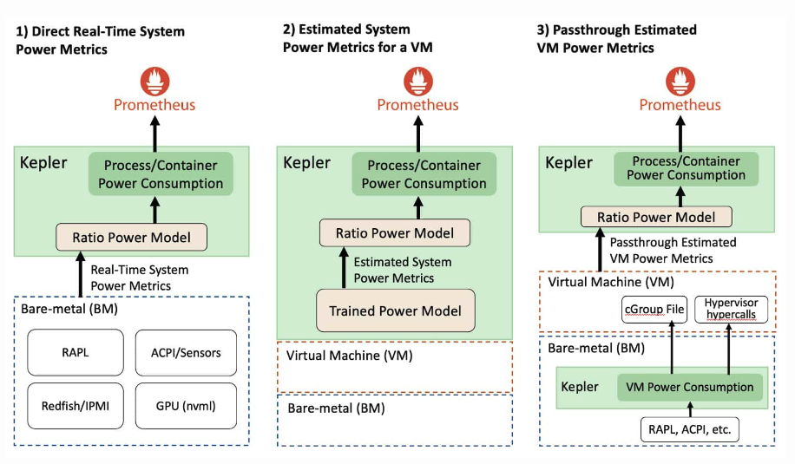

Slide 27
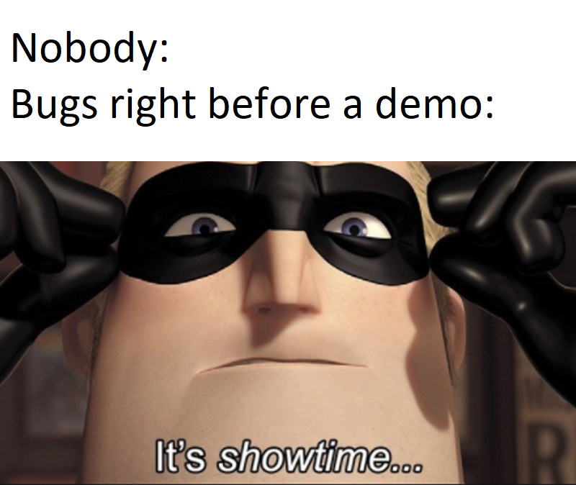

Slide 28
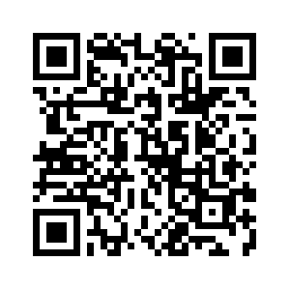
Demo

